Slide 1
INTERACTIVE and ACCESSIBLE PDFs
Gain the “know-how”

Slide 2
LEARNING OBJECTIVES
Know how to create interactive PDFs
Know how to create accessible PDFs
INTERACTIVE and ACCESSIBLE PDFs Quality Blended Learning

Slide 3
CREATING INTERACTIVE PDFs
INTERACTIVE and ACCESSIBLE PDFs Quality Blended Learning
INTERACTIVE and ACCESSIBLE PDFs Quality Blended Learning

Slide 4
HOW TO PREPARE
Get ready to create an interactive PDF:
Design with InDesign! | Design your pages in InDesign as you would normally do. Your document need to be (almost) finished before you start adding interactivity into it.
To interact or not to interact? | Decide which kind of interactivity you would like to add. Instructional design can help you on where it is useful to include interactive objects in order to not overdo it with them!
Identify the needs! | Prepare yourself for engaging interactive content! Identify your target audience and their needs, use marketing psychology to trigger their curiosity, use your creativity to make your content fun, combine data with visual content, invite your students to participate and last and most importantly, don’t forget to personalize your content.
Facilitator box:
Read the Golden Principles of High-Quality Instructional Design to find out more!
INTERACTIVE and ACCESSIBLE PDFs Quality Blended Learning

Slide 5
HOW TO CREATE YOUR OWN INTERACTIVE PDF
Once you are ready to go, all you have to do is follow the next 3 steps to create your own interactive PDF!
1
2
INTERACTIVE and ACCESSIBLE PDFs Quality Blended Learning

Slide 6
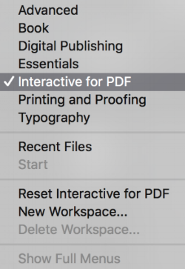
STEP 1
Open your InDesign file and select the Interactive for PDF Workspace. All panels are displayed on the right side of the screen
INTERACTIVE and ACCESSIBLE PDFs Quality Blended Learning

Slide 7
STEP 2
You can add hyperlinks by clicking the relevant panel and then selecting any element from your InDesign document.
In the Hyperlinks panel, click the ‘Create New Hyperlink button’ and add your hyperlink URL/file/email/page/destination/text anchor.
Add Hyperlinks
Those hyperlinks allow viewers to jump from location to another
within the same document, or to other documents or websites.
INTERACTIVE and ACCESSIBLE PDFs Quality Blended Learning

Slide 8
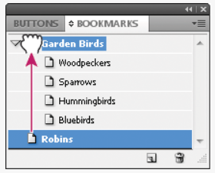
STEP 3
You can also add bookmarks to pages within the document by clicking on the ‘Create New Bookmark’ button in the Bookmarks panel.
Add Bookmarks
INTERACTIVE and ACCESSIBLE PDFs Quality Blended Learning

Slide 9
OTHER RESOURCES
Adobe Learn & Support
Practice with sample files how add a splash of interactivity to make your PDFs more engaging
YouTube
There are several tutorials on YouTube that can help you learning how to create interactive PDFs
Tip:
Add a keyword that describe the purpose of your PDF (e.g. resume, flyer, etc.)
INTERACTIVE and ACCESSIBLE PDFs Quality Blended Learning

Slide 10
WHAT TO AVOID
There are many mistakes and pitfalls that are quite common for teachers. Be aware of them and differentiate yourself from the others!
Interactivity is exciting! But don’t overdo it!
You have plenty of options! Remember to keep consistency throughout your content.
INTERACTIVE and ACCESSIBLE PDFs Quality Blended Learning

Slide 11
EVALUATE YOURSELF!
You can start creating your content before you explicitly define the needs of your audience.
Click on the correct answer
True
False
INTERACTIVE and ACCESSIBLE PDFs Quality Blended Learning

Slide 12
EVALUATE YOURSELF!
Answer A is incorrect!
You should always prepare yourself for engaging interactive content! Identify your target audience and their needs, use marketing psychology to trigger their curiosity, use your creativity to make your content fun, combine data with visual content, invite your students to participate and last and most importantly, don’t forget to personalize your content.
INTERACTIVE and ACCESSIBLE PDFs Quality Blended Learning

Slide 13
EVALUATE YOURSELF!
Answer B is correct!
Identifying the needs of your audience is a key step in creating effective content!
INTERACTIVE and ACCESSIBLE PDFs Quality Blended Learning

Slide 14
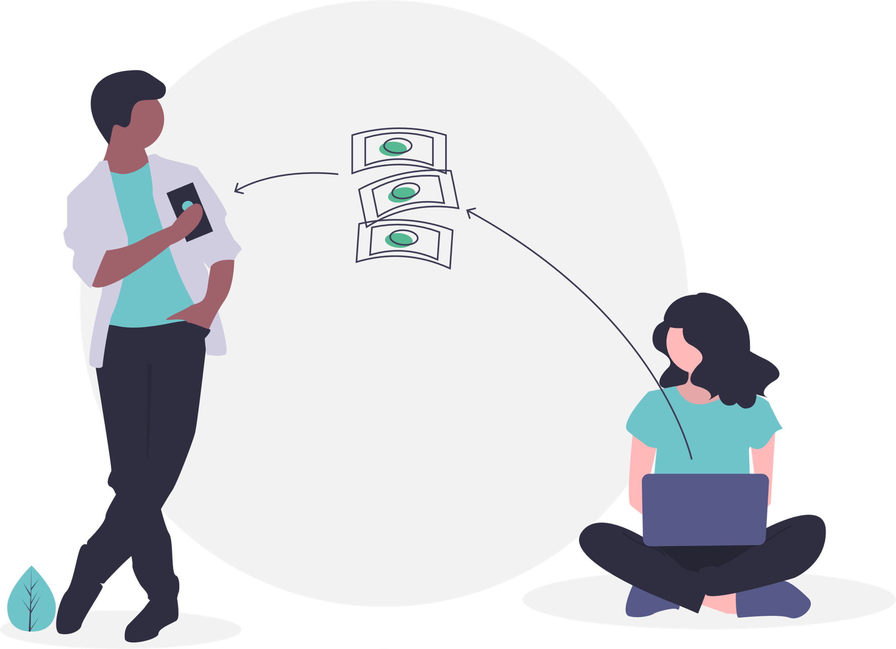
CREATING ACCESSIBLE PDFs
INTERACTIVE and ACCESSIBLE PDFs Quality Blended Learning
INTERACTIVE and ACCESSIBLE PDFs Quality Blended Learning

Slide 15
HOW TO PREPARE
Get ready to create an accessible PDF:
Use more tags! | PDFs must be properly tagged, with tags that are generated during the conversion from Word to PDF.
Be an architect! Define the structure! | The structure must be clear and easy to follow. Headings, table of contents, links and bookmarks can keep your structural elements properly formatted.
Be alternative! | Visual content that reveals useful information should have text alternatives.
Watch your language! | The language of the material should be specified in advance.
Fast and secure! | The security settings of the document shall include users of assistive technologies.
INTERACTIVE and ACCESSIBLE PDFs Quality Blended Learning

Slide 16
HOW TO CREATE YOUR OWN ACCESSIBLE PDF
Once you are ready to go, all you have to do is follow the next 3 steps to create your PDF accessible!
1
2
INTERACTIVE and ACCESSIBLE PDFs Quality Blended Learning

Slide 17
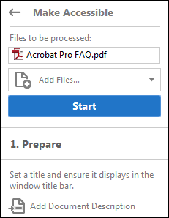
Activate the Make Accessible action of Adobe Pro Tool to see all the guidelines you need
Select the files you want to apply the predefined actions
Click start and follow the instructions to complete the Make Accessible action
1
2
3
INTERACTIVE and ACCESSIBLE PDFs Quality Blended Learning

Slide 18
OTHER RESOURCES
Adobe Learn & Support:
Make PDFs accessible (Acrobat Pro)
Check accessibility of PDFs (Acrobat Pro)
Fix accessibility issues (Acrobat Pro)
Accessibility issues
YouTube
There are several tutorials on YouTube that can help you learning how to create interactive PDFs
INTERACTIVE and ACCESSIBLE PDFs Quality Blended Learning

Slide 19
WHAT TO AVOID
There are many mistakes and pitfalls that are quite common for teachers. Be aware of them and differentiate yourself from the others!
Do not use images just to decorate your content. All material included in your document should convey useful information.
Avoid repeating headers and footers.
Be careful of the colours! The background shall make a contrast with the foreground.
INTERACTIVE and ACCESSIBLE PDFs Quality Blended Learning

Slide 20
EVALUATE YOURSELF!
Which of these is a good piece of advice when creating accessible PDFs?
Click on the correct answer
Readers love images! You can use as many as you want
Headers and footers shall be repeated in order for the readers to remember them
The background should have a contrasting colour with the foreground
INTERACTIVE and ACCESSIBLE PDFs Quality Blended Learning

Slide 21
EVALUATE YOURSELF!
Answer A is incorrect!
Screen reader users include people who are blind, have low vision, or have cognitive disabilities.
Avoid using non essential and non informative images such as decorative media. Use only relevant images and always add an alternative text.
INTERACTIVE and ACCESSIBLE PDFs Quality Blended Learning

Slide 22
EVALUATE YOURSELF!
Answer B is incorrect!
Some screen readers will automatically read header and footer information. Others require the user to navigate to the header or footer and manually “ask” for them to be read. Others leave headers and footers out completely.
While it’s important to mark header and footer information somewhere else in the text since headers and footers usually include essential information such as contacts, it can be frustrating for an impaired user to automatically hear this information every time they click on a new page.
INTERACTIVE and ACCESSIBLE PDFs Quality Blended Learning

Slide 23
EVALUATE YOURSELF!
The correct answer is C!
The background shall make a contrast with the foreground. This helps people with visibility problems to easily read your content.
INTERACTIVE and ACCESSIBLE PDFs Quality Blended Learning

Slide 24
THANK YOU!
This slides were created by the Quality Blended Learning Consortium
Please keep this slide for attribution.
DISCLAIMER. This project has been funded with support from the European Commission. This publication [communication] reflects the views only of the author, and the Commission cannot be held responsible for any use which may be made of the information contained therein.

